Slide 1

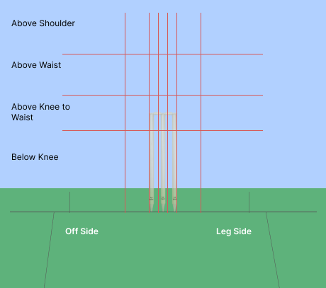
India vs Afghanistan 1st T20I (Mohali)
Afghanistan Pace Bowlers vs RHB Batters
 |  |  | 400
0
300 | 133 | 250 | 100 | 0 | 400
50 |  | 400 | 80

Slide 2
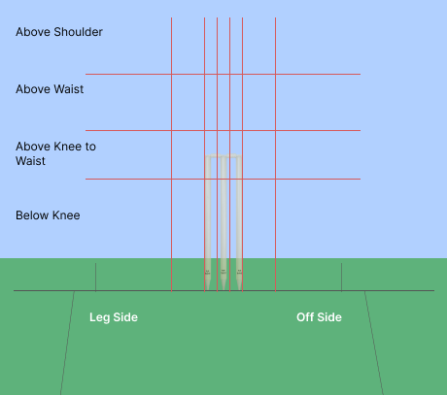
India vs Afghanistan 1st T20I (Mohali)
Afghanistan Pace Bowlers vs LHB Batters
 |  | 400 | 100
 | 300 |  | 100 |  | 200
 | 50 | 600 | 100 | 50 | 138 | 400
 | 100 | 67 | 100 | 350 | 100

Slide 3
India vs Afghanistan 1st T20I (Mohali)
Afghanistan Spin Bowlers vs RHB Batters
 |  |  | 25 |  | 0
 | 400 | 0 |  | 400 | 400

Slide 4
India vs Afghanistan 1st T20I (Mohali)
Afghanistan Spin Bowlers vs LHB Batters
 |  | 100 | 0 | 0 | 43 | 100
 | 250 |  | 325 | 0 | 200 | 33

Slide 5
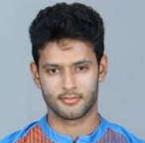
India vs Afghanistan 1st T20I (Mohali)
Afghanistan Pace Bowlers vs Shivam Dube
 |  | 400 | 100
 | 300 |  |  |  | 100
 | 50 |  | 100 | 100 | 114 | 400
 | 100 | 100 | 100 | 600

Slide 6
India vs Afghanistan 1st T20I (Mohali)
Afghanistan Spin Bowlers vs Shivam Dube
 |  |  |  | 0 | 0 | 100
 |  |  | 550 | 0 | 100 | 50

Slide 7
India vs Afghanistan 1st T20I (Mohali)
Afghanistan Pace Bowlers vs Shivam Dube
Variation | Runs | Balls | SR
Stock Ball | 31 | 19 | 163.16
Slower Ball | 9 | 6 | 150.00
Bouncer | 5 | 2 | 250.00
Total | 45 | 27 | 166.67
Afghanistan Spin Bowlers vs Shivam Dube
Variation | Runs | Balls | SR
Arm Ball | 13 | 7 | 185.71
Carrom Ball | 0 | 1 | 0.00
Googly | 1 | 4 | 25.00
Off Spin | 1 | 1 | 100.00
Total | 15 | 13 | 115.38

Slide 8
India vs Afghanistan 1st T20I (Mohali)
Afghanistan Pace Bowlers
NAVEEN-UL-HAQ | Runs | Balls | SR
Bouncer | 9 | 3 | 300.0
Slower Ball | 9 | 6 | 150.0
Stock Ball | 25 | 12 | 208.3
Total | 43 | 21 | 204.8
FAZALHAQ FAROOQIII | Runs | Balls | SR
Bouncer | - | - | -
Slower Ball | 4 | 3 | 133.3
Stock Ball | 22 | 15 | 140.0
Total | 26 | 18 | 138.9
AZMATULLAH OMARZAI | Runs | Balls | SR
Bouncer | - | - | -
Slower Ball | 12 | 8 | 150.0
Stock Ball | 21 | 16 | 131.3
Total | 33 | 24 | 137.5
GULBADIN NAIB | Runs | Balls | SR
Bouncer | - | - | -
Slower Ball | 2 | 2 | 100.0
Stock Ball | 10 | 4 | 250.0
Total | 12 | 6 | 200.0

